Slide 1

Presentation on FOOD FOR NEEDY
Team members :-
Niru Kumari Mishra (740325)
Rabin Phaiju (740329)
Rodip Duwal (740334)
Roshan Dumaru (740335)

Slide 2
Content
Introduction
Motivation
Statement of Problems
Objectives
Scope
Literature Review
Methodology
Expected Outcome

Slide 3
Introduction
Food is any substance consumed to provide nutritional support for an organism.
Food waste is very common.
Food should be utilized properly.
Food For Needy, a platform to fill appetite for hunger.

Slide 4
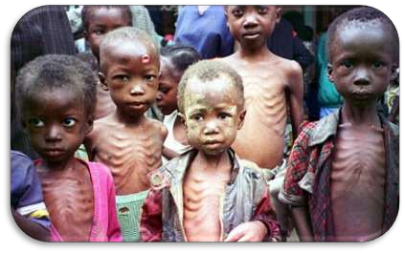
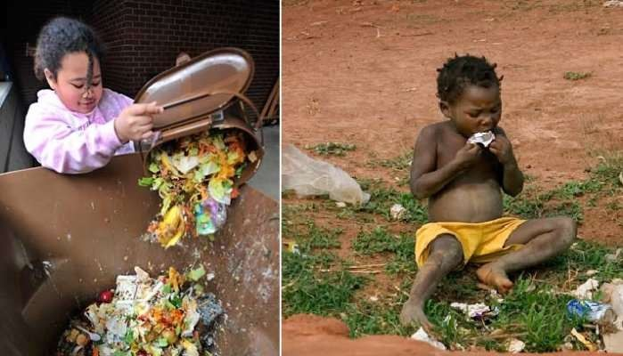
Motivation
Causes from Food Loss and Food Waste.
Don’t waste food “THE KATHMANDU POST” [ Nov-12-19 ]

Slide 5
Statement of Problems
World Statistics.
Categorization of food.
No proper display of food item's details.

Slide 6

Objectives
To provide a platform that:
Aware People
Promote free food services to needy.

Slide 7
Scope
Build a platform to link food donator and needy.
Aware about the actual value of food.
Monitor food waste in all food outlets.
Host in web.

Slide 8
Literature Review
Poor nutrition causes nearly 28% deaths in children under five.
No existing legal system for donating food like in foreign countries.
Related projects (FoodRescue, Groliste, Foodtank etc.)
Issue such as
No categorization
Details of Food are not shown

Slide 9
Methodology
project will be carried out
References (FoodTank, Food Rescue , Groliste etc.)
Tools & Platform
Sublime
JS
PHP
HTML
Bootstrap
Apache Server

Slide 10
Expected Outcome
Displaying Organized and detail of product.
Categorization of items.
Implement in Nepal.

Slide 11

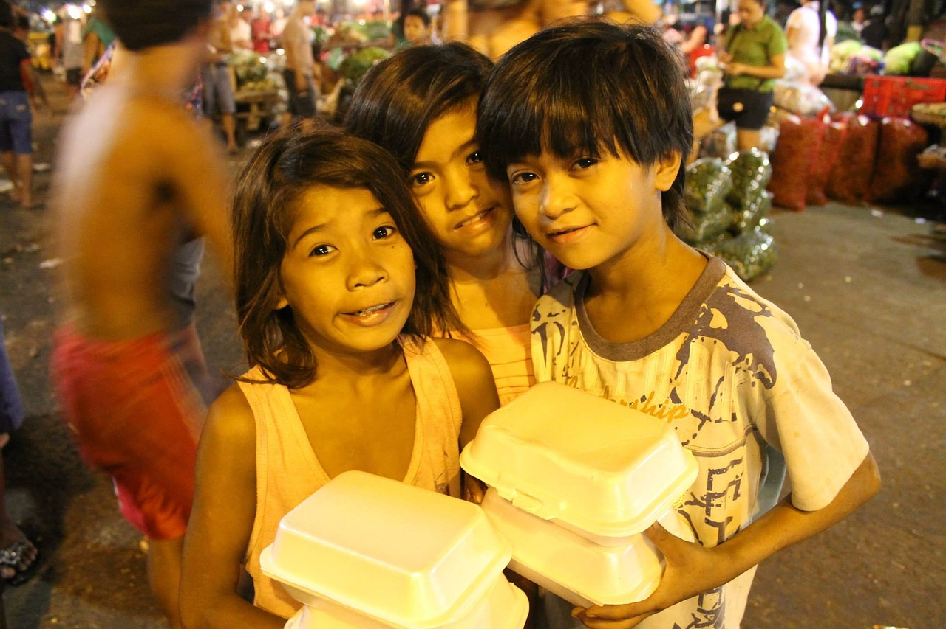
Any Queries !!!

Slide 12
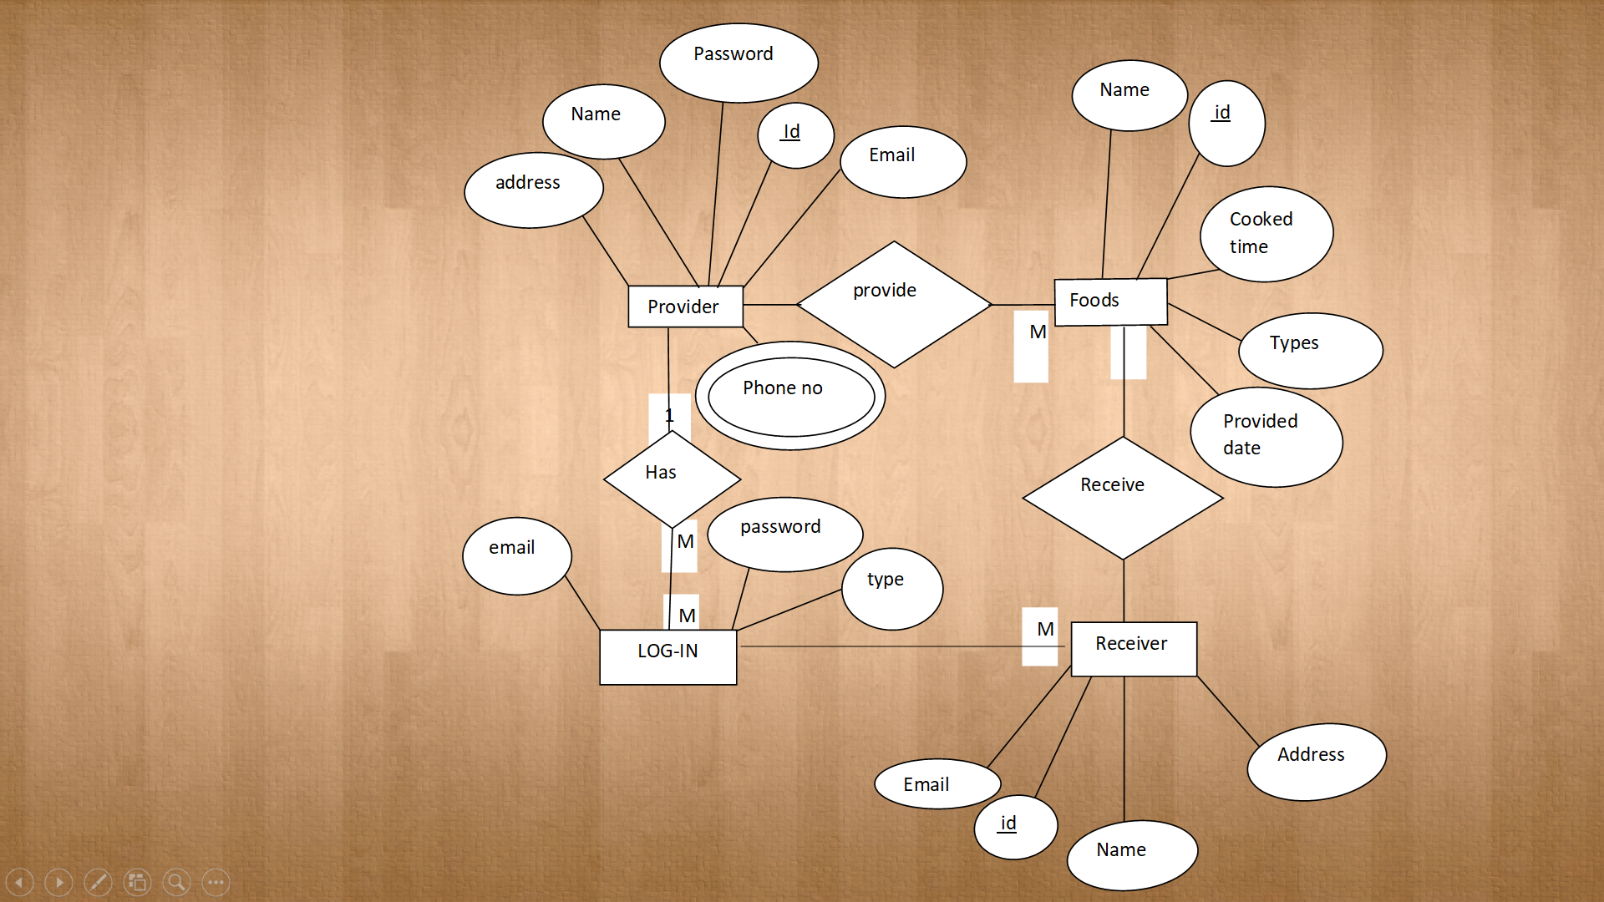
E-R Diagram

Slide 13
Work Breakdown Structure
S.N | Week JobDescription | 1stWeek | 2ndWeek | 3rdWeek | 4thWeek | 5thWeek | 6thWeek | 7thWeek | 8thWeek
1. | Problem Identification
2. | Analysis
3. | Design
4. | Coding
5. | Implementation and testing
6. | Documentation

